Slide 2
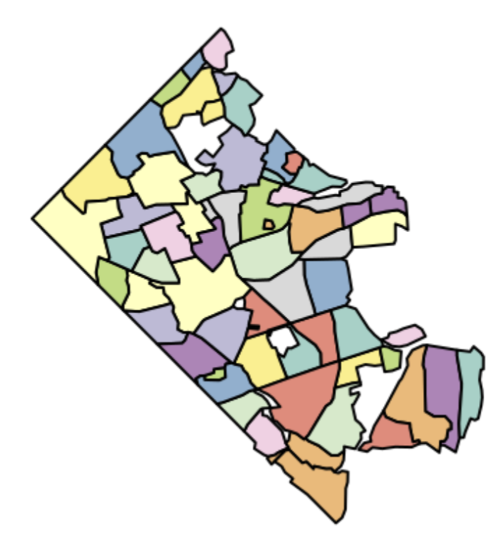
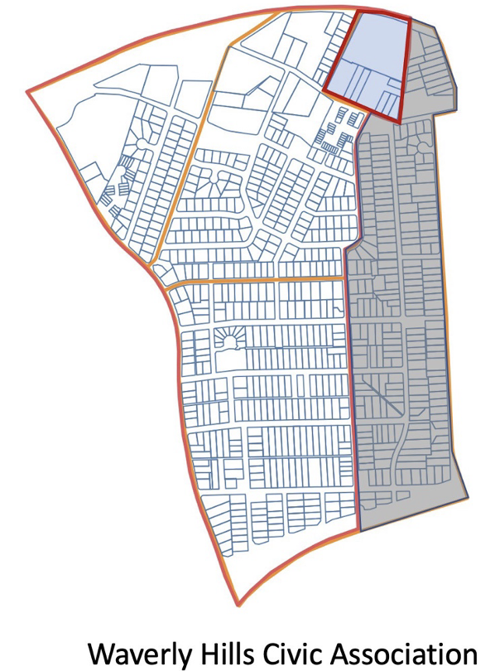
Target Civic Assoc Geography
Census Data Geographies
Approach
Need to include
Distribute block group totals evenly to each residence (e.g., a population of 100 divided by 25 residences would equals 4 people per residence)
Aggregate back just the residences from the area to include
Combine with other block group totals
* Potential modifications available such as a different population multiplier for apartments vs detached single family homes
1007005
1006003
1007001
Need to remove
1007002

